Slide 1


Australian School Based Apprenticeships (ASBAs)
DI DAVIDSON Transition and Careers
SUE BIRKETT VET Coordinator

Slide 2
What is an ASBA?
It is a combination of paid work $ $
(1 or 2 days per week) + College-based study
leading to a Year 12 Certificate.
You can finish College with a Nationally
Recognised Certificate or Statement of
Attainment as well as a Year 12 Certificate.
(This can take reduce the time for a full-time apprenticeship)

Slide 3
Certificate II qualification = 1 point approx
(students complete 4 lines + Connect)
*Requires a minimum of 8 hours
(equivalent to one day) in the workplace
+ a minimum of 3 hours off the job training per week
How many points?

Slide 4
How many points? cont’d
Certificate III qualification= 2 points
(students complete 3 lines + Connect)
*requires a minimum of 12 hours in the
workplace and 3 hours of training.
(may require further work and study after the
completion of Year 12)

Slide 5
Why do an ASBA?
Get paid
Fast-track a vocational pathway: get your
Certificate II or III whilst still at College
Combine an industry qualification with a
more academic package
Build skills, experience and industry contacts
Recognise extra qualification on the Year 12 Certificate
** Students do not have to continue with the
apprenticeship post Year 12 but can transfer to full-time

Slide 6
How do I get an ASBA?
Find an employer- talk to friends/relatives do Work Experience
ring local businesses
give Di your resume
convert a part-time job eg McDonalds
The employer will contact an Australian Apprenticeship Support Network provider to
do the sign-up
Complete a white-card if needing to go onto a
Construction Site
*MBA take on some ASBA’s in March each year.
An application and interview process applies.
These will be advertised through College.

Slide 7
The role of the Australian Apprenticeship Support Network
organise the sign-up of an ASBA
(fill in the contract)
provide assistance to employers, ASBAs and RTOs throughout the duration of the Australian Apprenticeship
work with The Directorate to provide an integrated service
advise schools of potential ASBAs

Slide 8
What is an RTO?
The Registered Training Organisation is nominated by the employer to provide the underpinning theory for the qualification.
Gungahlin College is an RTO for:
Certificate II and III in Business
Certificate II Kitchen Operations/Hospitality
Certificate II and III in Sport and Recreation
Certificate II in Live Theatre Production
Certificate II in IT
Certificate II in Tourism
**Trades Qualifications will have an external RTO eg CIT

Slide 9
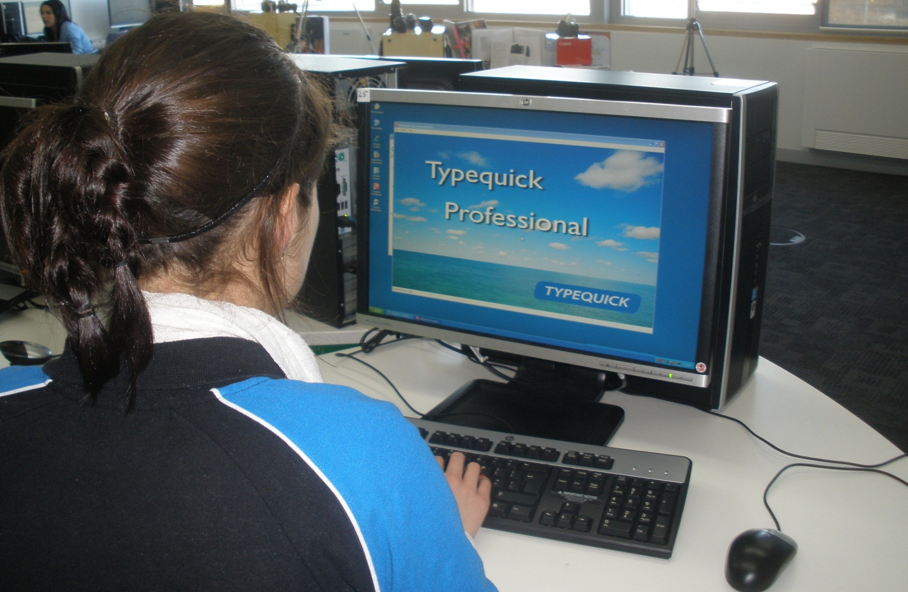
Students train in Business Administration
(Business Cert II and III at Gungahlin College)

Slide 10
A selection of possible ASBA’s
Cert II in Auto | Cert III in Carpentry
Cert II in Construction | Cert III in Hairdressing
Cert II in IT | Cert III in Childcare
Cert III Plumbing | Cert III in Electrical
Cert II and III in Kitchen Ops | Cert III in Hospitality – front of house
Cert II in Horticulture | Cert III in Disability
Cert II/III in Retail | Cert III in Bricklaying
Cert II/III in Business | Cert II/III in Sport and Recreation
Some ASBA positions are available in schools- IT, Business, Disability, Sport and Rec Send electronic resume to diane.davidson@ed.act.edu.au

Slide 11
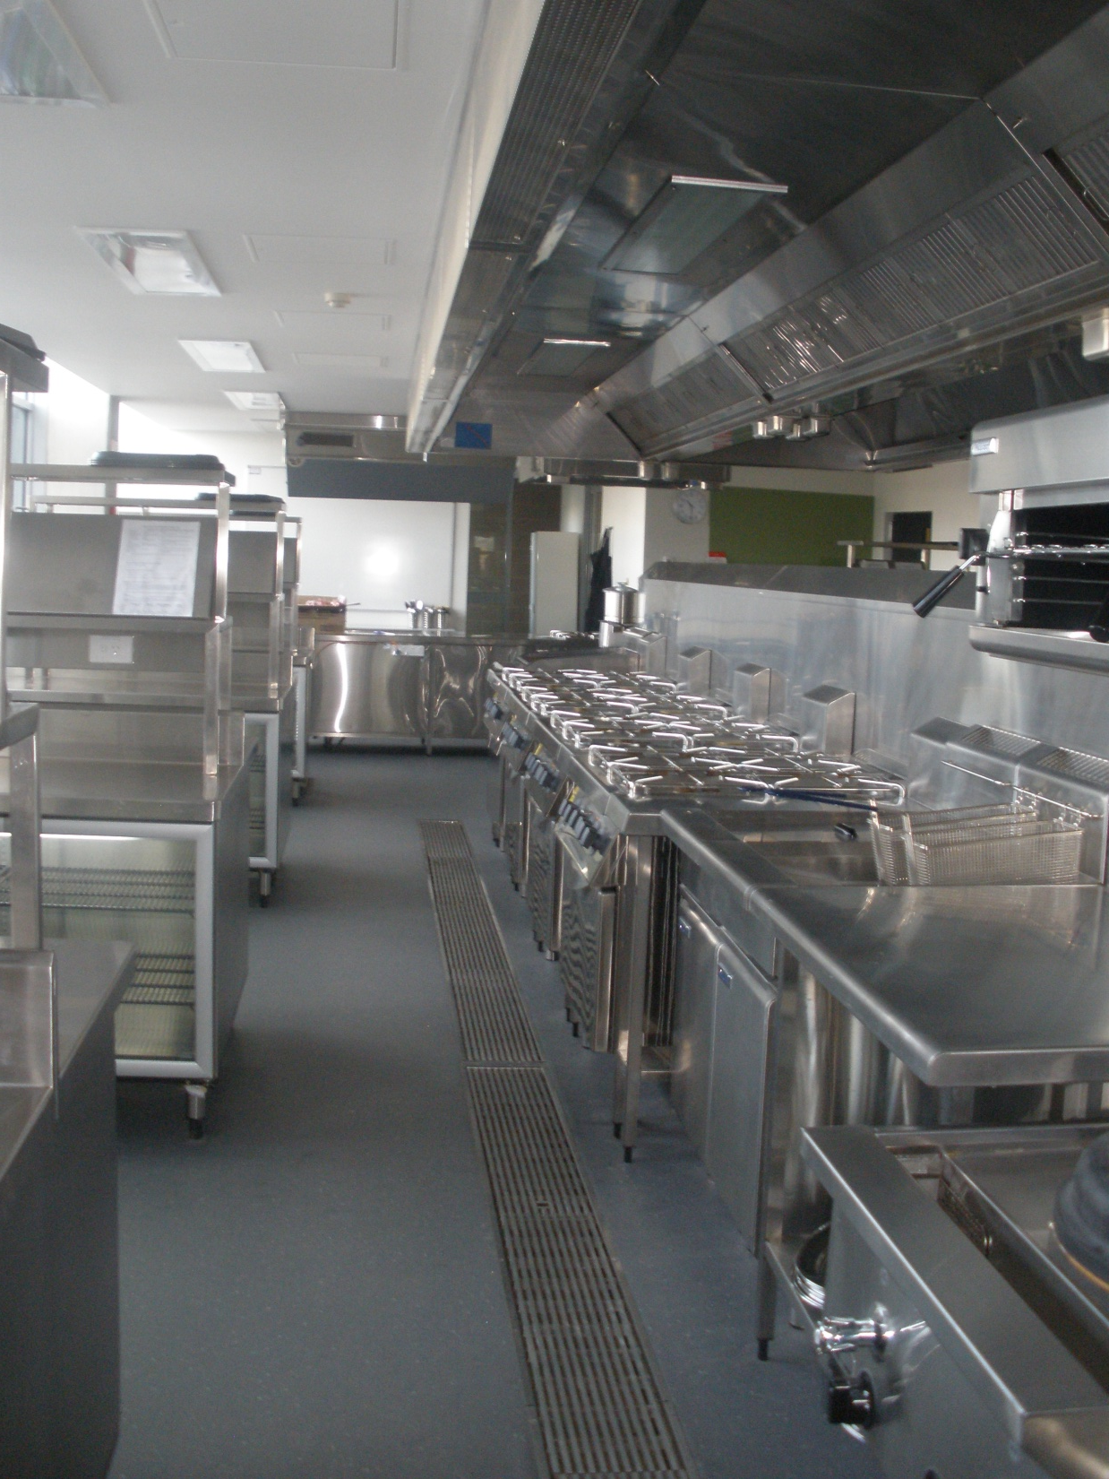
State-of–the-art kitchen used by Hospitality students-
Kitchen Operations Certificate I and II

Slide 12
Resources
For more information go to: http://www.education.act.gov.au/school_education/vet_for_secondary-students/asba /
Pre-Apprenticeship Self Assessment Tool for Electrotechnology Trade
http://www.ulmitb.com.au/PreApprenticeshipPracticeTest/HomeStateForm.do
Numeracy for jobs/range of aptitude tests
http://www.gtasa.com.au/resources

Slide 13
Sources to assist in finding an ASBA
Access the Federal Government Website –"How to find an Australian Apprenticeship" at http://www.australianapprenticeships.gov.au/
Other websites that can help you are:
www.skillsroad.com.au
www.aapathways.com.au

